Slide 1

Banwasi Seva Ashram Govindpur
Shubha Prem
Sonbhadra, Uttar Pradesh, 231221
Web-site: www.banwasisevaashram.in

Slide 2
Banwasi Seva Ashram
BSA is a voluntary organisation and believing in Gandhian principles of life. BSA was founded in 1954.
Vision: BSA envisages a strong new village culture, incorporating the positive values of traditional life and benefits of modern knowledge in such a way that neither people nor nature are unduly exploited.
Mission: To establish Gramswarajya: village level self-rule and self sufficiency (sustainability), which will promote ‘Sarvoday’, welfare for all, through gram swarajya sabha’s. Gram kosh and village land, a school and basic health knowledge in every village.

Slide 3
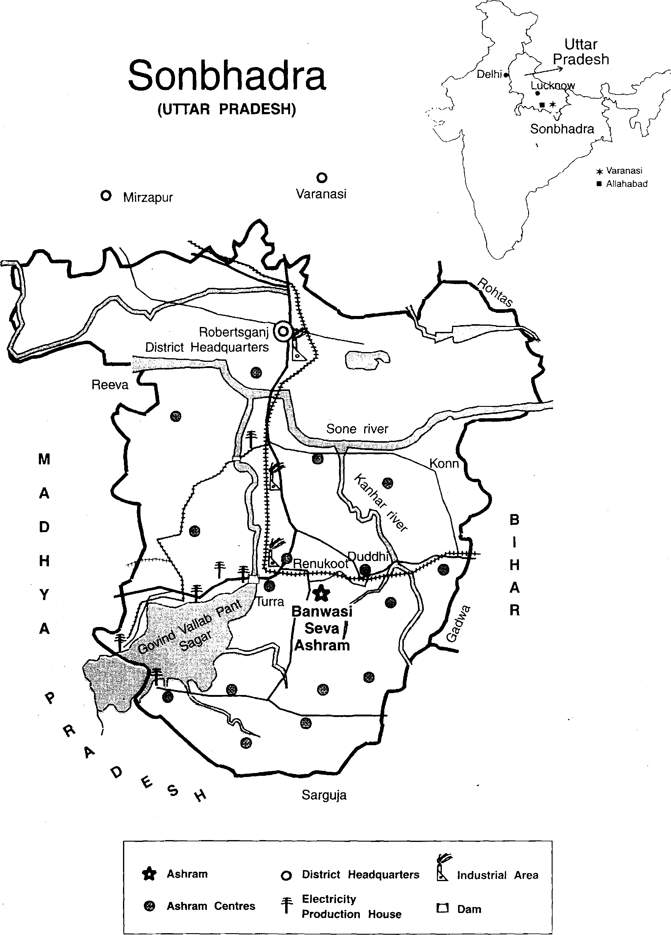
Work Area: South Sonbhadra, U.P.
400 Villages in South Sonbhadra ,covering about 4 lakh people
Sonbhadra district is challenging place to work
Undergoing fast industrialization due to mineral resource rich land
Chronic poverty, drought, unemployment.
Poorest attainment rates on all educational parameters
Tribal dominated area with fast decreasing forest land

Slide 4
Our Approach
Analyse problems find workable solutions for addressing the root cause
Implement solutions by helping community members work out models which can be managed by them with appropriate training
Involvement of the community, all stake-holders, subject experts and also the government officials
Main outcome: change in the thinking process and attitude of the villagers

Slide 5
Ashram Programs
Rural health and medical care
Education for children
Women empowerment
Khadi Gramodyao (Village Industries)
Organic Farming and Horticulture
Environmental Health
Rural Entitlement, Legal Support and Awareness Generation

Slide 6
Highlights of Achievements
A three tier people's organisation: to promote people's initiative for community development . Consist of 445 Gram Swarajya Sabha in 230 villages. 80 Development forum. Village fund- gram kosh involving all families, labour bank.
BSA’s development activities
Water and soil conservation, land development
(1380 earthen dam, 1115 irrigation well, 25660 acre)
Education: 7 schools established (3000 students per year), 125 non-formal education centre, total literacy campaign in 216 villages, life orientation of youth (900 /year) through camps

Slide 7
Achievements
Rural health education through 160 health friends and rural health service, 25000 patients treated per year
Women’s empowerment: 160 Gram Sakhies with 124 SHGs promoted equality in society and started taking leadership.
Employment oriented apprentice training in crafts and services (3215 youth have benefitted so far)
Public interest litigation in Supreme Court for land rights, rights of the displaced and bonded labour
Representation of environmental pollution problem in south Sonbhadra at different levels

Slide 8
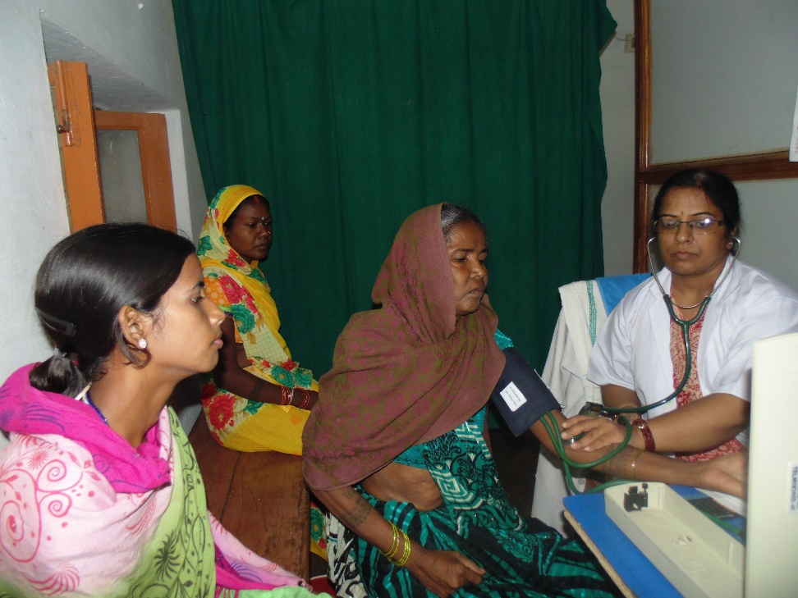
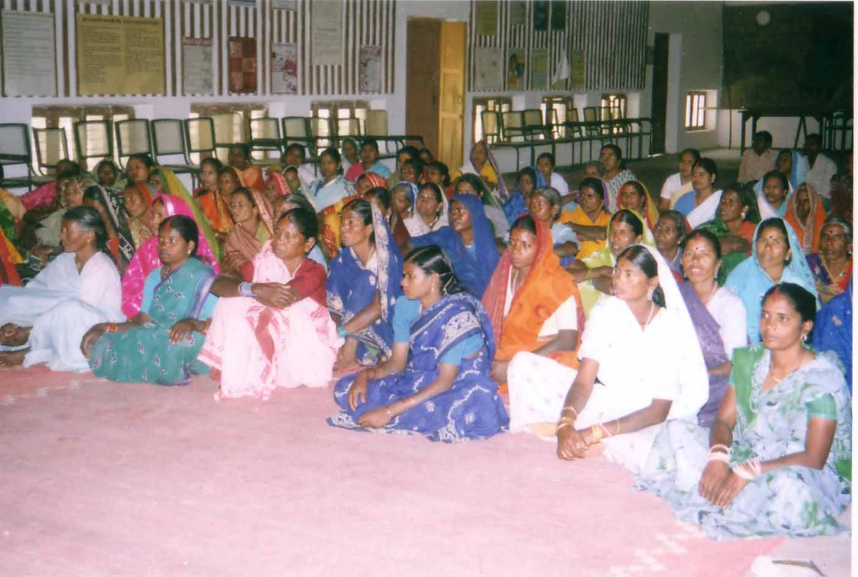
Glimpses of Ashram Work
Gram Sakhi meeting
Ashram Health Center

Slide 9
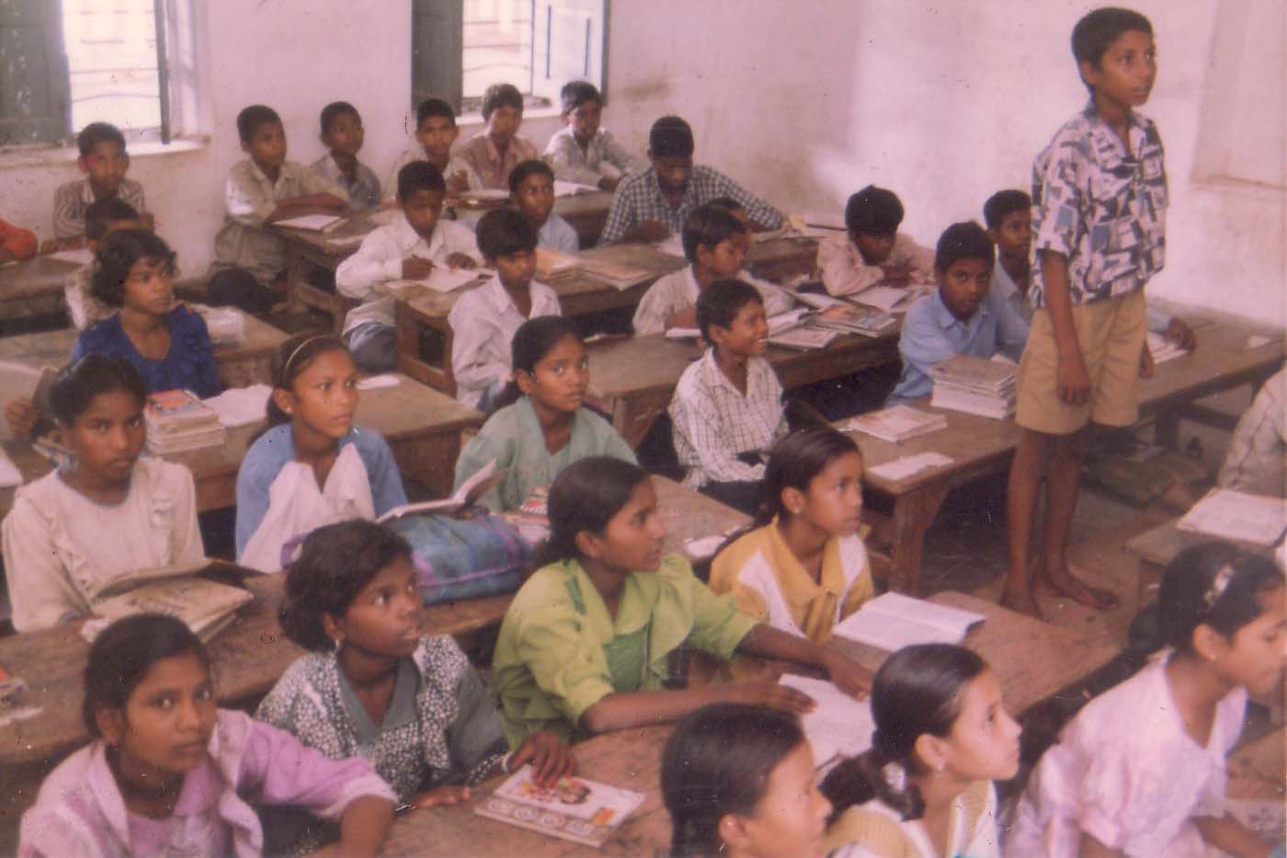
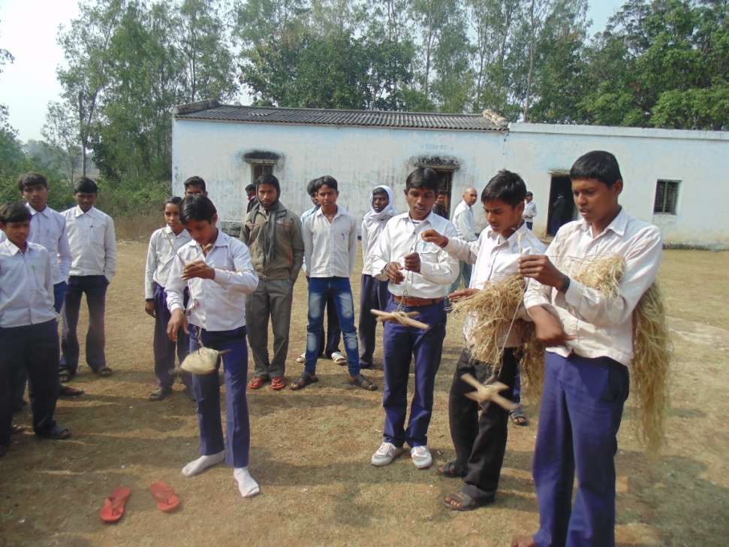
Glimpses of Ashram Work
Jeevanshala Bakuliya
Life oriented education at Ashram schools

Slide 10
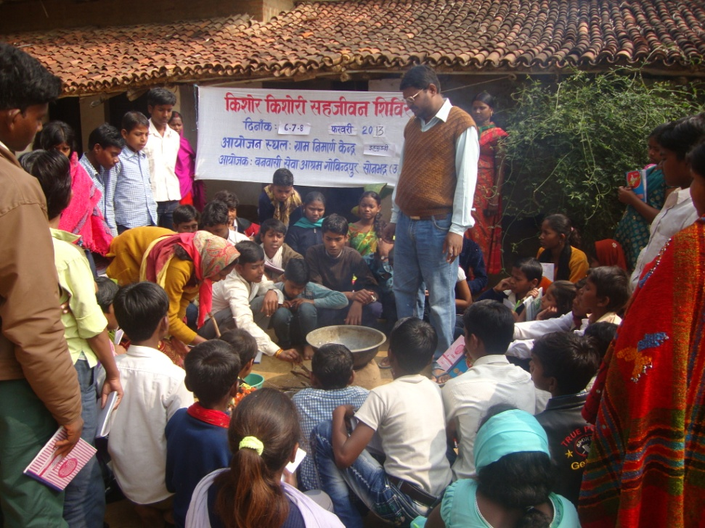
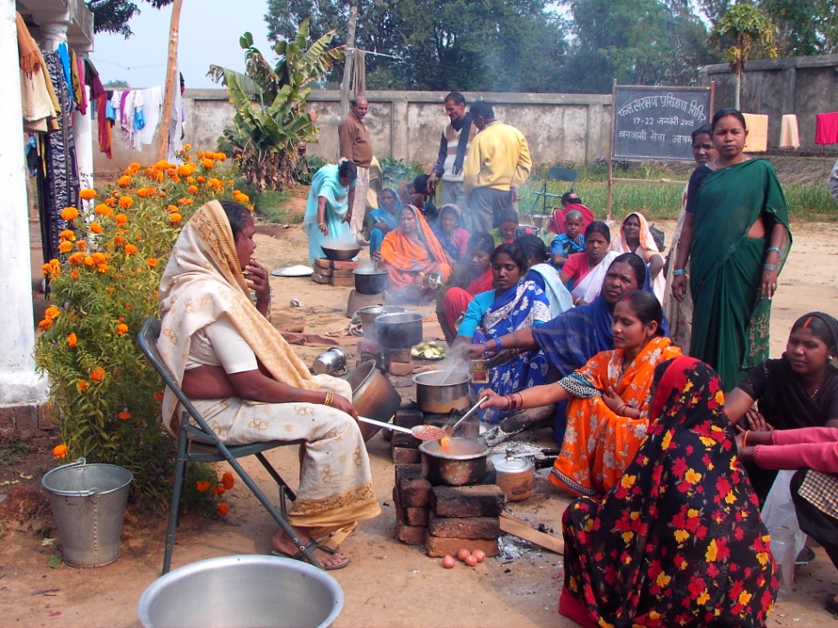
Glimpses of Ashram Work
Training on fruit preservation
Life oriented adolescents camp

Slide 11
Our Strengths
Gram Swarajya sangthan (People’s Organization) spread across 400 villages
Agrindus Demonstration farm, High School and Health Clinic at Govindpur main campus
13 rural centres and 2 urban centres
Master Trainers in various fields
Grass-root workers and volunteers trained in different areas of expertise
Ongoing short-term project and long term programs

Slide 12
Ongoing and Future Work
Skill development and experiential learning center
Running schools with special emphasis on holistic values based quality education.
Creating a model for self-governance through community participation and connecting various development initiatives
Marketing network to support sustainable agro-industry based village economy.
Agrindus demonstration farm promoting watershed based and natural farming practices
Promoting holistic approach to health and providing quality health services.

Slide 13
A Centre for
Experiential Livelihood Education and Training

Slide 14
Motivation
Many local youth migrate to cities in search of jobs. They end up working as unskilled casual laborers due to lack of skills needed to survive in city markets
Youth who stay back in villages need multiple skills to survive and cannot bank on a single traditional vocational skill in the family
It is necessary to channelize energies of village youth towards social transformation and protect them from falling prey for emerging evils such as addictions and violence

Slide 15
Aim
Provide experiential education and livelihood training to enhance employability and provide students with relevant knowledge and skills that align with the demands of village ecosystem and city job markets.
Develop awareness of societal needs, build character and leadership abilities to prepare them to address the many more challenges of life and the society along with preparing individuals for specific livelihoods or careers

Slide 16
Focus and Approach
Skill development: Experiential education focuses on developing practical skills that are directly applicable to specific careers or livelihoods. These skills may include technical skills (apprenticeships and project-based learning) and soft skills (communication, teamwork, leadership).
Real-world integration: It emphasizes the integration of real-life contexts and experiences into the learning process.

Slide 17
Focus and Approach
Collaboration with industry: Close collaboration with local industry partners and employers is essential for imparting experiential education. This collaboration can take the form of curriculum development, guest lectures, mentorship programs, and internships, which provide students with exposure to real work environments.
Entrepreneurship and innovation: Experiential education encourages an entrepreneurial mindset and fosters innovation. It equips students with the skills to identify opportunities, take risks, and develop innovative solutions to problems.

Slide 18
Possible Programs
Training center with village industry workshop (equipped with modern tools for crafts and purchase of learning material)
Training courses:
  Repair and maintenance of motor bikes, Motor winding, Pumps, Mobile Phones, Solar Lamps etc.
  Services- maintenance of pipe lines, hand pumps, electrical wiring
  Production of organic manures and pesticides, Natural farming practices
  Agricultural product processing and marketing
  Village industry and Khadi production and processing

Slide 19
Possible Programs
In addition to focusing on the vocational training, these one to six month training programs will include awareness on village self-governance, gender equality, climate change and more.
Mobilization of village youth for adopting the vocational skill for earning their livelihood will be an integral part of the center activity.

Slide 20
Implementation Plan
This programs is envisaged for five years with aim of training 50 student each year.
Ashram has basic infrastructure for khadi and village craft training, which needs upgradation
For technical skills be associated with local workshops and industries
Estimated cost of implementing the program is Rs. 10 lakhs per year (30% coordination and administration, 20% upgradation of facilities and training material, 50% for running residential courses)

Slide 21

Thank you for your attention!
Questions …..??

